Slide 1


2025
Acupuncture NZ
Annual Conference
8-9 November 2025
Novotel Auckland Ellerslie
Auckland Tāmaki Makaurau
Speakers List

Slide 2
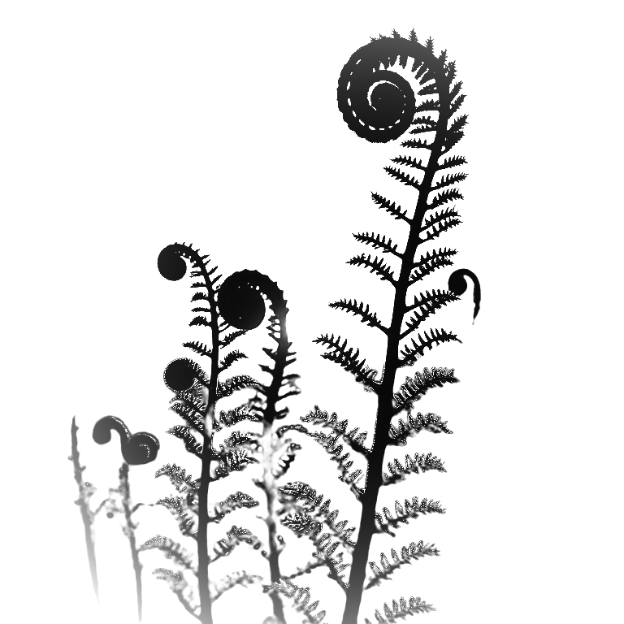
Presentations for the 2025 AcNZ Conference (from a-z)
John Black - Explaining Acupuncture/TCM to the public
Debra Betts and Jason Bei - Collecting data from clinical practice -examples and the potential
Dr Slate Burris - Neoclassical Acupuncture: A root level, palpatory approach with instant symptomatic results
Dr Liu Chijing - Clinical Diagnosis and Treatement Based on Unique Pulse
Dr Zhiwei Ding -Workshop - Fundamental Concepts of Cutaneous Perforators and the Interpretation of the Overlap Between Cutaneous
Perforators and Acupoints
Shelley Moana Hiha - Te Tiriti o Waitangi - a pathway for all in Aotearoa
Peter Larking - Workshop: Safety Precautions and Contraindications in Electroacupuncture: Evidence-Based Guidelines for Clinical Practice
Thomas Lin - “One Million Silver Needles: A Cultural Donation Initiative Reflecting the Legacy of Acupuncture in New Zealand”
Dr Beinan Liu - Clinical Interpretations of the "Ci Shu”(Acupuncture) Chapter from the Tianhui Medical Bamboo Slips.
Vicki Martin Mackay - The Microbiome and the TCM large intestine – The pure of the impure - A novel perspective
Lindsey Pine and Kate Roberts - Normalising Complaints in Chinese Medicine: A Regulator's Perspective
Ada Sobieszczuk - Workshop: An Introduction to the classical view of the Extraordinary Channels
Jean Paul Staats - Mental Health and the Classics
Xiaojuan Sue Sun - Clinical Insights and Treatment Experience in Managing Cough
Ting Vivian Wang - An Integrative Acupuncture-Based Model for Managing Depression, Anxiety, and ADHD
Renjie Xi - Workshop: Introduction into Pediatric Tuina
Alice Xian - Workshop: Health Qigong and Therapeutic Tai Chi for Common Conditions: Preliminary Exploration, Application,
and Training of TCM Exercise Prescriptions
Dr Hungchun Yin - Principles and Applications of Modern Tongue Diagnosis

Slide 3
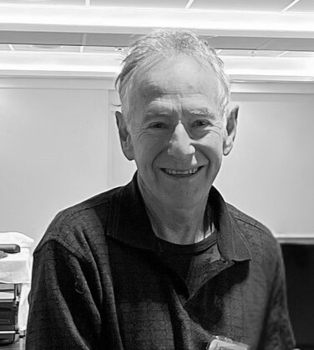
Explaining Acupuncture/TCM to the public
In my more than 3O years of Traditional Chinese Medicine (TCM) practice in Nelson, I have frequently been invited to explain TCM and acupuncture to different interest groups.
My main aim has been to demystify acupuncture, as although to many laypeople, it is a mysterious, almost mystical therapy, I have learned how to explain it in a way that makes sense to people, including correspondences between yin yang etc and modern western medical physiology
About the Presenter
Originally qualified as a teacher of English as a second language, John Black was treated by a TCM doctor for psoriasis in Bangkok in 1983 while teaching English there. The treatments which took a year, became lessons in TCM.
After completing treatment, John continued studying with the doctor every weekend for another year, before deciding to study formally. He spent 2 years studying Mandarin, and then became the first foreign student of Shandong University of TCM graduating in 1993.
John has been practising TCM (acupuncture, tuina and herbal medicine) in Nelson since 1994. He was appointed guest professor of Shandong Academy of Medical Sciences in 2O12 and was invited to give lectures to TCM doctors in Shandong, China in the same year, and again in 2O17.
John Black

Slide 4
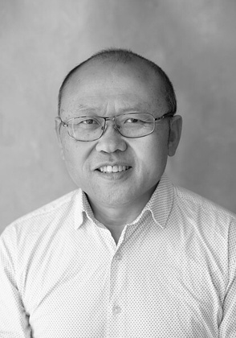
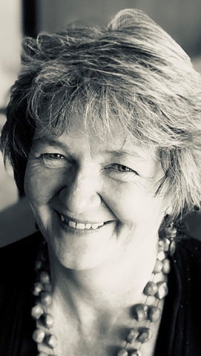
Collecting data from clinical practice -examples and the potential
Join Jason and Debra to explore what clinical data you can gather from your acupuncture clinic—and why this is vital to showcasing the effectiveness of acupuncture in clinical practice.
Jason will share insights from his work with the NZCAP veterans’ initiative, including how he collects structured feedback from participants. He will also demonstrate a free app he uses in practice, which allows patients to report on their use of breathing exercises, food therapy, and self-administered moxibustion—modalities he integrates into his holistic treatment approach.
Debra will present a range of free outcome measures that acupuncturists can easily implement in their clinics. She will focus on how these
tools can support acupuncture providers in self-evaluation and promoting the care they provide.
The session will conclude with an open discussion, inviting participants to reflect on what data they currently collect (or would like to collect) in their own clinics, and how they might implement meaningful systems of measurement.
Join us for a practical and forward-looking conversation about how to harness clinical data to support our patients—and to help acupuncture grow as a respected and evidence-informed health profession.
Jason Bei
and
Debra Betts

Slide 5

About the Presenter
Debra Betts is the author of “The Essential Guide to Acupuncture in Pregnancy & Childbirth” published in 2OO6 and subsequently translated into German and French. With a nursing background she completed her acupuncture training in London in 1989. On returning to New Zealand her interest in pregnancy led to setting up acupuncture and acupressure courses for midwives.
In 2OO8 Debra founded a hospital antenatal acupuncture clinic at Hutt hospital that provided free acupuncture treatment during pregnancy in conjunction with the New Zealand School of Acupuncture (NZSATCM). In 2O14 she completed her PhD on the use of acupuncture in threatened miscarriage through the University of Western Sydney and went on the develop and teach on a master’s program for acupuncturists though NZSATCM.
She is the founder of an online mentoring and for acupuncturists in pregnancy care. In addition, Debra continues to publish articles relating to acupuncture use in pregnancy and lecture internationally on the use of maternity acupuncture and acupressure.

Slide 6
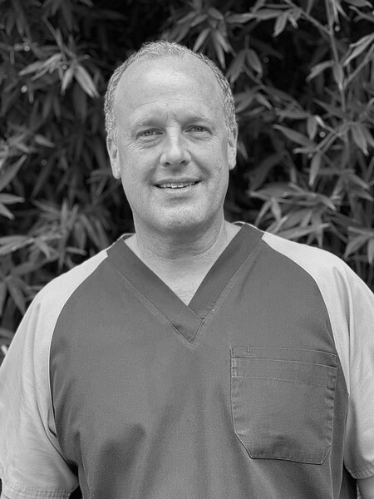
Neoclassical Acupuncture: A root level, palpatory approach with instant symptomatic results (an online presentation)
Neoclassical Acupuncture is a palpatory method of acupuncture with which the practitioner can diagnose and treat the root level, with immediate changes in the symptomatic level. In this presentation we will see how simple it is to diagnose the root level in just seconds and via that deeper level remove painful symptoms instantaneously without needing to know the symptoms beforehand.
The secret to this system is the instantaneous feedback provided through palpation of various areas of the body. We will be showing a variety of feedback mechanisms used which take the guesswork out of the treatment. With these mechanisms the practitioner can know not only if he/she has chosen the correct point for each step of the treatment, but whether not the point location is really correct. While legs can be palpated to check the state of the meridians, the trunk of the body is palpated to determine the state of organs as well as elemental imbalances. Of course alleviation of symptoms play a role on the most superficial level of feedback.
The algorithms in this method have evolved to the point where in a majority of cases the patient can receive complete pain relief with only one needle, with treatment only at the root level, and no need to know the symptoms beforehand. In this presentation basic levels of treatment within the system will be discussed with several demonstration to show the deep efficacy of treatment.
Dr Slate Burris

Slide 7
About the Presenter
Through his study of the classics and clinical experience, Dr. Burris, over the past two decades, has developed Neoclassical Acupuncture, a palpatory technique based on a 6 element model with instant results on both root and symptomatic levels. In 2O19 he published Neoclassical Acupuncture which has been published in English, Russian and Spanish.
Dr Burris has trained thousands of acupuncturists in Europe, Asia, and North America in this unique palpatory style of acupuncture. He moved to Mexico in 2OO6 to start free clinics in the mountains of Oaxaca. He continues to live in Mexico with his wife and two children

Slide 8
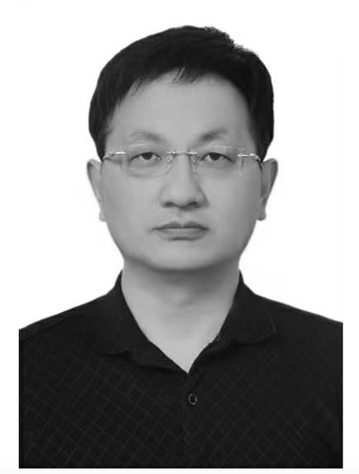
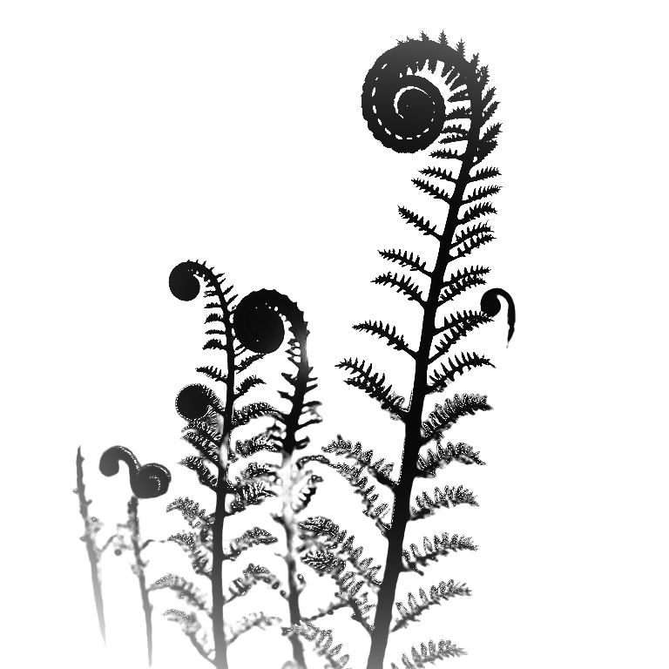
Workshop - Fundamental Concepts of Cutaneous Perforators and the Interpretation of the Overlap Between Cutaneous Perforators and Acupoints
This lecture will focus on the theory of skin perforators, systematically introducing its fundamental concepts and exploring the significant overlap between perforator vessel locations and traditional acupuncture points. It highlights the deep connection between classical meridian theory and modern microsurgical anatomy.
The content includes an in-depth explanation of the five characteristic sensations (Deqi) associated with perforator needling, with optional hands-on experience. The lecture will also review previous related studies and compare them with recent findings to provide a comprehensive understanding of the theory’s evolution.
Preliminary analysis of perforator signal characteristics will be shared, offering new insights for clinical application and research. This session is ideal for professionals interested in the modernization and precision development of acupuncture.
The workshop will cover:
An explanation of the Five Types of Needling Sensations Associated with Cutaneous Perforators
Overview and Comparison of Previous Research on the Overlap Between Cutaneous Perforators and Acupoints
Preliminary Analysis of the Characteristics of Signals from Cutaneous Perforators
Dr Zhiwei
Ding

Slide 9
About the Presenter
Dr Ding has over 2O years of clinical experience in orthopedics, he independently discovered a one-to-one correspondence between perforator vessels and acupuncture points, leading to the creation of the "perforator needling technique" that integrates acupuncture with modern anatomical science.
Currently working in the Pain Department of Weifang People's Hospital, he focuses on precise acupoint localization, electroacupuncture innovation, and related research, having trained over 6OO) professionals.

Slide 10
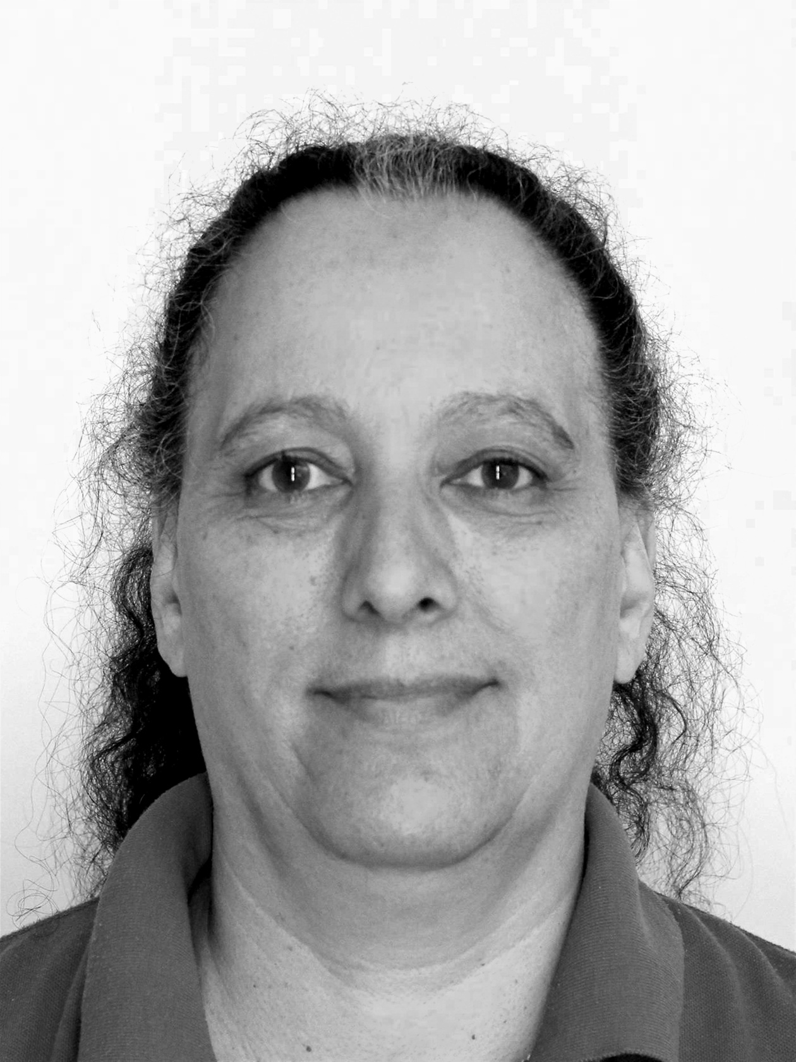
Te Tiriti o Waitangi - a pathway for all in Aotearoa
About the Presenter
Shelley Moana Hiha
Ngati Kahungunu, Ngai Tahu, Ngati Rangitihi
Mataora / Cultural Policy Advisor and Educator
I was fortunate to be mentored in my early years in Whanganui a Tara by several people critical to the shift to Te Tiriti o Waitangi based organisational structures and the implementation of Kawa Whakaruruhau Cultural Safety within healthcare in Aotearoa in the first instance. My work in unions developed my political curiosity and engagement in activities advocating for social justice and equity and this passion continues in my mahi today.
After retiring from most of my Sports Massage Therapist mahi I continue to provide support and education to future health practitioners and provide cultural supervision and support to those who have been working in healthcare, education and sport. I am passionate about the potential of Te Tiriti o Waitangi as a positive way forward for our nation, for us all - Kotahitanga.
Shelley
Moana Hiha

Slide 11
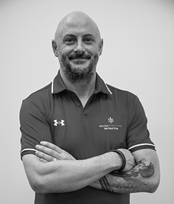
Workshop: Safety Precautions and Contraindications in Electroacupuncture: Evidence-Based Guidelines for Clinical Practice
As electroacupuncture becomes more widely adopted within modern clinical practice, ensuring practitioner competence in the safe application of electrical stimulation is essential. This 3-hour practical workshop, led by Pete Larking, will focus on safety precautions, contraindications, and evidence-informed approaches to electroacupuncture dosage and device selection.
The session will begin with a detailed overview of the principles of electrical dosage in acupuncture, outlining the key parameters practitioners must understand, such as frequency, pulse width, current intensity, waveform, length and frequency of treatment. Pete will present a framework for identifying safe stimulation ranges and discuss what minimum technical specifications devices should meet to ensure patient safety.
Participants will explore the differences between various types of electroacupuncture devices, comparing their safety features, clinical functions, and stimulation capabilities. Devices ranging from simple low-cost models to advanced programmable units will be reviewed, with particular attention to their suitability for different clinical scenarios.
Following this, participants will explore the differences between various types of electroacupuncture devices, comparing their safety features, clinical functions, and stimulation capabilities. Devices ranging from simple low-cost models to advanced programmable units will be reviewed, with particular attention to their suitability for different clinical scenarios.
Peter
Larking

Slide 12
Cont.
The workshop will then cover the five Neuropuncture electrical dosage mechanisms currently supported by peer-reviewed research, including local tissue repair anti-inflammatory pathways, spinal segmental mechanisms, peripheral nerve polarization, central nervous system modulation, autonomic regulation and deep cranial electromagnetic acupuncture.
Building on this foundation, the session will address common clinical contraindications and necessary precautions when treating patients with specific conditions (e.g., pregnancy, epilepsy, pacemakers, surgical implants, chronic fatigue syndrome and functional neurological disorder), providing guidance on risk mitigation, informed consent and clinical record keeping.
This workshop is ideal for acupuncturists looking to expand their knowledge of electroacupuncture while prioritizing patient safety and upholding best-practice standards.
About the Presenter
Pete Larking is a senior practitioner and educator of Chinese medicine with over 25 years of clinical and teaching experience. He holds a BHSc (Acupuncture), diplomas in Tuina, Qigong, and Taijiquan, and is a certified Neuropuncture practitioner and instructor. Pete has taught biomedical sciences, neurological anatomy, and acupuncture theory at the NZ School of Acupuncture and continues to teach across Australasia.
He is Medical Director of Neuromedtec and delivers Neuropuncture services at Masterton Medical. Known for integrating traditional Chinese medicine with modern neuroscience, Pete makes complex material practical and accessible for clinicians.

Slide 13
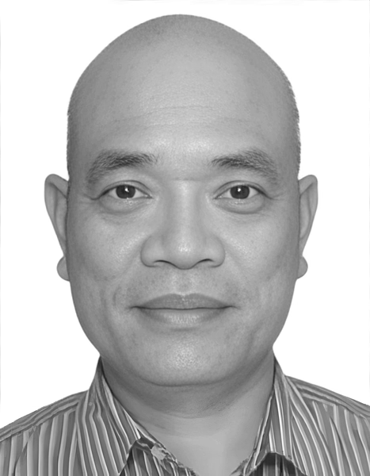
“One Million Silver Needles: A Cultural Donation Initiative Reflecting the Legacy of Acupuncture in New Zealand” (presented during the conference dinner)
In 2O25, I initiated a symbolic cultural donation project involving the collection and gifting of one million acupuncture needles to Canterbury Museum, one of New Zealand’s most respected public cultural institutions.
The project is designed to commemorate the development of Traditional Chinese Medicine (TCM) and acupuncture practice across Aotearoa over the past three decades — as experienced by myself and the wider Chinese medicine community.
Having previously donated 1OO,OOO clinically used but safely preserved acupuncture needles to three museums in China — in Beijing, Guangzhou, and Shanghai — I saw the need to anchor a similar cultural symbol within New Zealand’s heritage landscape. This new collection, supported by practitioners nationwide, reflects not only our clinical tools but the collective memory, service, and identity of Chinese health professionals contributing to New Zealand society.
The presentation will detail the motivations behind the initiative, the process of preservation and safe display of used clinical artefacts, collaboration with museums and community partners, and responses from both local and international supporters. It will also explore the role of TCM in building cross-cultural understanding, and how symbolic actions can enhance public engagement with our profession.
This project aims to inspire other practitioners to contribute to heritage storytelling and help preserve our place within the wider healthcare and cultural narrative of Aotearoa New Zealand.
Thomas Lin

Slide 14
About the presenter
Thomas Lin is a Registered Chinese Medicine Practitioner with over 3O years of experience in acupuncture and Chinese herbal medicine. He is the founder of the TCM Chinese Medical Centre in Christchurch and has previously served in advisory roles with the Chinese Medicine Council of New Zealand and the Health and Disability Commissioner.
Lin has been a long-time advocate for cultural exchange and has made several donations of TCM artefacts to museums in both China and New Zealand.

Slide 15
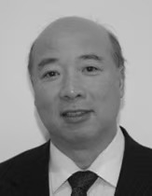
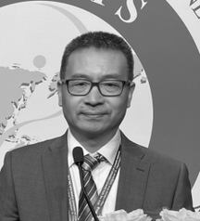
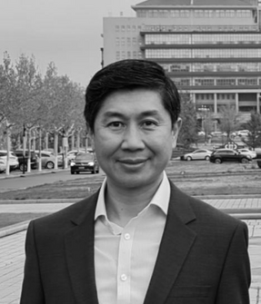
This esteemed delegation of global alumni from Shandong University of Chinese Medicine will be giving brief presentations of their talks from the recent 22nd World Congress of Chinese Medicine in held in Sydney.
Dr Chijing Liu will present on Clinical Diagnosis and Treatment Based on Unique Pulse.
Dr Hongchun Yin will present on the Principles and Applications of Modern Tongue Diagnosis
Dr Beinan Liu will present on Clinical Interpretation of the "Ci Shu" (Acupuncture) Chapter from the Tianhui Medical Bamboo Slips.
Dr Chijing Liu,
Dr Beinan Liu &
Dr Hongchun Yin
About the Presenters
Dr Chijing Liu began his TCM training in 1975 under a master-apprentice system in Shandong and graduated from Shandong University of Traditional Chinese Medicine in 1983.
Secretary-General of the Australian Federation of Chinese Medicine and Acupuncture, Vice President of the World Federation of Chinese Medicine Societies, and President of the World Pulse Diagnosis Research Committee. His clinical research focuses on pulse diagnosis and dermatological treatments, and he has presented extensively at international TCM and dermatology conferences, including the World TCM Congresses.

Slide 16
About the Presenters cont.
Dr. Hongchun Yin graduated from Shandong University of TCM in 1988. In 2OO6, he has established his Chinese Medicine clinic in London. He created the Modern Tongue Diagnostics (MTD) system and has over thousand students. Currently he serves as a president of International Association of MTD, executive board member of WFTCM. Adviser of FTCMP. Adviser if CICM of KCL.He has published three books: “Morden Tongue Diagnostics in Chinese Medicine “,”principles and Atlas of Yin’s MTD”, “yin’s Tongue Diagnostics based herbal methodology “.
Dr. Beinan Liu, Chief TCM Physician and Professor President of the Overseas Alumni Association of Shandong University of Traditional Chinese Medicine； Vice President of the Association of Traditional Chinese Medicine (UK) ；Council Member of the World Federation of Chinese Medicine Societies ；Professor at Dan Huang TCM Institute (UK) Founder of Huakang Center in Scotland. Liu graduated from Shandong University of Traditional Chinese Medicine in 1993, majoring in TCM and part of the 85th class for young students.

Slide 17
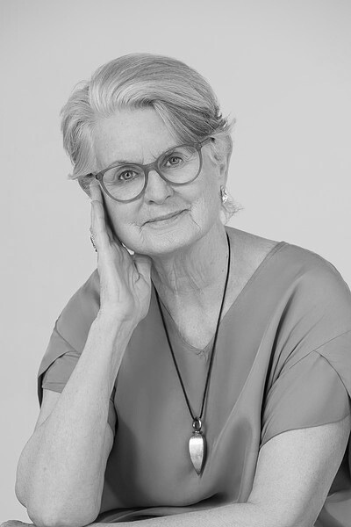
The Microbiome and the TCM Large Intestine – The Pure of the Impure - A Novel Perspective
The microbiome has emerged as a substantial focus of scientific research over the past ten years, attracting thousands of researchers worldwide. Its growing significance lies in its potential to revolutionise our understanding of a wide range of health conditions. From neurodegenerative disorders like Parkinson's disease to increasingly prevalent metabolic diseases—including diabetes, obesity, cardiovascular diseases—as well as cancer and arthritis, the microbiome offers new avenues for diagnosis, treatment, and prevention.
But where, in the vast and intricate pantheon of Traditional Chinese Medicine (TCM), can the microbiome find a place? Can it truly make itself at home within a diagnostic system developed thousands of years ago? Surprisingly, there’s no conflict—in fact, the microbiome has always been there, just beneath the surface. It may not have been labelled as such, but its presence is deeply woven into TCM concepts such as Spleen Qi, Dampness, Stagnation, and the balance of Yin and Yang in the digestive system. Bob Flaws, in his groundbreaking 199O book “Scatology & the Gate of Life”, was among the first to highlight a discrepancy in contemporary TCM practice: the apparent underestimation of the Large Intestine's function.
At that time, the term "microbiome" had not yet been coined, but in his typically iconoclastic style, Flaws devoted over 9O pages to arguing why this specific organ deserved far more attention. Since then, a growing number of TCM dietary therapy specialists have echoed his insights, gradually opening the conversation around the microbiome and its relevance to TCM. As Andrew Sterman aptly notes, “far from merely handling the elimination of solid wastes, the large intestine carries out important functions in the digestive process”. “Far beyond that of waste disposal”.
Vicki Martin
Mackay

Slide 18
Cont.
This presentation will examine how common microbiome dysfunctions—dysbiosis, leaky gut, and inflammation—can be understood and addressed through a TCM perspective.
Method: Literature search from recognised TCM practitioners of Chinese Dietary Therapy including Bob Flaws, Peter Deadman, and Andrew Sterman will be utilised, along with relevant research papers.
References: “Scatology & the Gate of Life, the Role of the Large Intestine in Immunity, an Integrated Chinese-Western Approach”. Bob Flaws. Blue Poppy Press 199O. “Nourishing Life the Yang Sheng Way”. Deirdre Courtney. Singing Dragon 2O19. “Live Well, Live Long, Teachings from the Chinese Nourishment of Life Tradition”. Peter Deadman. The Journal of Chinese Medicine Ltd 2O16. “Welcoming Food. Diet as Medicine for Home Cooks and Other Healers. Book 1: Energetics of Food and Healing”. Andrew Sterman. Classical Wellness Press 2O2O.
About the Presenter
Vicki Martin Mackay is a registered dietitian with many years of nutritional counselling and teaching experience. She has a private nutrition practice specialising in assisting those with challenging health conditions utilising both integrative nutrition and complementary medicine approaches.
Vicki has completed a naturopathic diploma and studied traditional Chinese medicine extensively in China and Japan. She has a master’s degree in health sciences from the University of Auckland specialising in the human microbiome

Slide 19
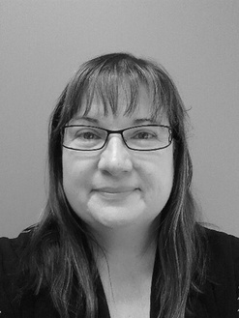
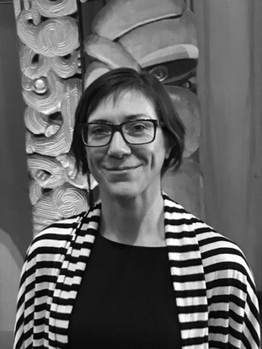
Normalising Complaints in Chinese Medicine: A Regulator's Perspective
Complaints are a common and expected aspect of healthcare delivery and are valuable opportunities for reflection, improvement, and quality assurance. Regulatory bodies like the Chinese Medicine Council of New Zealand (CMCNZ) are using clear and patient-focused methods to handle complaints. Around the world, there is a trend towards solving problems quickly and using data to find and fix bigger issues. In New Zealand, healthcare regulators, including the CMCNZ, are following these trends to improve how they deal with complaints.
When the CMCNZ receives a complaint, the process starts with looking at it and asking the practitioner for their side of the story. If needed, the complaint is sent to a Professional Conduct Committee (PCC) for a deeper investigation. The PCC collects evidence, talks to people involved, and makes suggestions, which can include mediation or disciplinary action.
To avoid complaints, practitioners of Chinese medicine should follow best practices like clear communication, getting informed consent, and sticking to clinical guidelines. Continuing professional development (CPD) and recertification, which includes staying updated with rules, also help reduce the risk of complaints.
This presentation looks at complaint trends both internationally and in New Zealand, focusing on the CMCNZ's practices. It aims to explain how complaints are handled in New Zealand and show why normalising complaints is important for improving Chinese medicine.
Lindsey Pine
and
Kate Roberts

Slide 20
About the Presenters
Lindsey Pine holds a Bachelor of Arts degree from Victoria University of Wellington in English Literature and Film and a Diploma in Business from the Open Polytechnic of NZ (Te Pūkenga).
Lindsey has worked in health regulation for more than 15 years for a number of regulators. Over this time, she has amassed a wealth of experience navigating complaints and competence matters, developing policy and standards, implementing recertification programmes and strategic frameworks, managing secretariats, and engaging with consumers, practitioners, and stakeholders. Lindsey was appointed to project manage the establishment of the Chinese Medicine Council of NZ in 2O22 and was later appointed as the Council's Registrar and General Manager in 2O23.
Kate Roberts PhD, MHSCI (TCM), BHSCI (Acu), PG Cert (MH), MAcNZ, MAMH, ACC Treatment Provider - works as a Professional Advisor to the Chinese Medical Council of NZ and has been involved in the development and consultation of the scopes of practice and the standards and accreditation documents for Chinese Medicine Practitioners. Kate holds a PhD in Primary Health Care, a Masters in Traditional Chinese Medicine, a Post-graduate Certificate in Psychological Medicine and a Bachelors of Acupuncture. She has additional qualifications in adult education and Te Reo Māori.
Kate is a registered Chinese Medicine practitioner (Acupuncturist) and Chinese Medicine Specialist (Mental Health). Her clinical practice focuses on the treatment of mental health and musculo-skeletal conditions. She utilises an evidence-informed approach and works within a collaborative framework with other allied and mainstream practitioners.

Slide 21
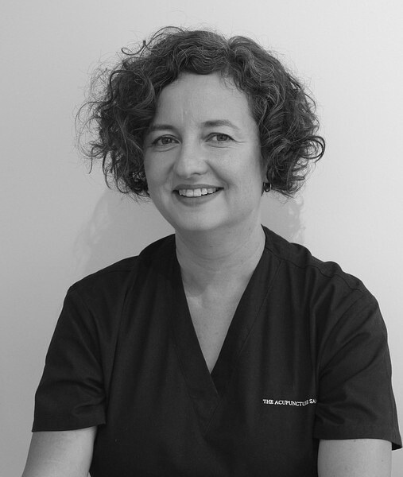
Workshop: An Introduction to the classical view of the Extraordinary Channels
When we reach the level of the 原 (yuán), we are no longer treating symptoms — we are listening to the whispers of our blueprint. The Eight Extraordinary Channels (奇經八脈 qí jīng bā mài) the deepest, most primordial channels of the body.
We start off in Chong (衝脈), the channel of our original Qi, original confidence. It is part of the first ancestry — the moment when sperm meets egg and heavenly Qi. Within that space of infinite possibility, here is this space. Here is the place of Chong. With that first cell division, we have Ren Mai (任脈) and Du Mai (督脈): the building blocks and the moving, warming Qi that builds the structure. Dai Mai (帶脈) holds the first ancestry all together.
As we are born, we step into space and time — time governed by the Wei Mai (維脈), with Yin Wei Mai (陰維脈) weaving the past and Yang Wei Mai (陽維脈) guiding us toward the future. As we stand in space, we turn inward, courtesy of Yin Qiao Mai (陰蹻脈), and we look outward into the world, supported by Yang Qiao Mai (陽蹻脈).
These channels can be used to treat issues that began in the first cycle of life, before the age of seven or eight — patterns related to birth trauma, inherited conditions, or anything affecting the DNA, the Jing (精), and beyond.
If you are interested in learning more about these channels from a classical perspective — how you might feel an Eight Extraordinary Channel pulse, and how you might needle to activate these vessels — I look forward to meeting you at this workshop.
Ada
Sobieszczuk

Slide 22
About the Presenter
Ada Sobieszczuk received her Traditional Chinese Medicine (TCM) degree from Beijing University of TCM and has spent nearly a decade deepening her understanding of Chinese medicine through a classical lens. She has studied the Classics as taught by Master Jeffrey Yuen and has received transmissions of the channels from his long-time student Ann Cecil-Sterman.
Ada loves teaching, learning, and sharing these rich practices, and she is grateful to return to the AcNZ conference to share and connect with colleagues. She is also a certified NLP practitioner and runs a thriving, heart-centered private practice in Titirangi, Auckland. Ada is passionate about the channels of acupuncture and how Chinese medicine principles apply to all aspects of life.

Slide 23
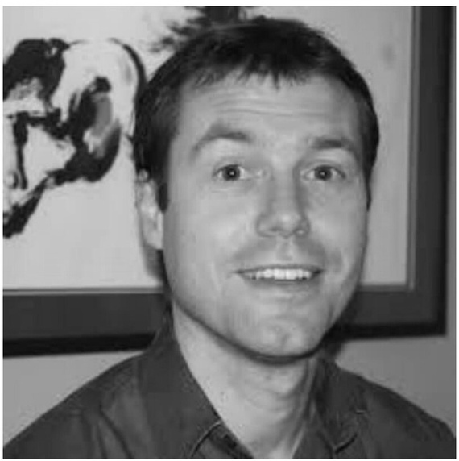
Mental Health and the Classics (an online presentation)
Today we are seeing more and more cases of mental health issues and people looking for help. Classical Chinese Herbal Medicine recognised and has incredibly successful strategies to help your patients.
We will look at the issues faced by patients and discuss the frame work to be able to offer real help. We will discuss a range of formulas that you can use in your clinics staright away.
About the Presenter
Jean-Paul Staats has practiced Acupuncture and Chinese medicine for 33 years in private practice in Australia and in Europe. He is Australian trained with postgraduate studies from hospitals in Beijing, Nanjing and Nanning in China, in Japan, as well as the USA and UK.
He has lectured at the Australian College of Natural Medicine (now Endeavour College) for 6 years and has since also been appointed Australian branch director of the Institute of Classics in East Asian Medicine (ICEAM) after completion of a Diplomat of Canonical Chinese Medicine Training and further studies towards a clinical fellowship. He is currently a lecturer and clinical supervisor for ICEAM in Australia.
Jean-Paul
Staats

Slide 24
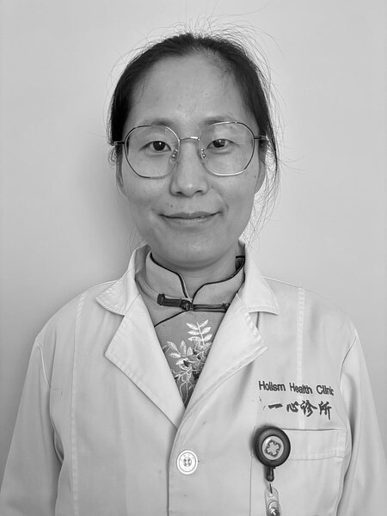
Clinical Insights and Treatment Experience in Managing Cough
This lecture will examine the classification and differential diagnosis of cough, therapeutic strategies, and representative clinical cases. Coughs are broadly divided into two categories - externally contracted and internally generated — and the treatment rationale for each category differs completely. An accurate diagnosis in both Traditional Chinese Medicine (TCM) and Western medicine, including careful differential diagnosis, is essential; the goal is to address the underlying cause rather than merely suppress the cough itself. Among externally contracted coughs, treatment approaches vary with the six external pathogenic factors (wind‑cold, wind‑heat, summer‑heat, dampness, dryness, and fire). In particular, coughs due to damp‑heat or constrained heat require special consideration within this group.
In clinical practice, coughs related to acute or chronic pharyngitis and laryngitis often present significant therapeutic challenges and typically require the use of specialized medications. In pediatrics, post-viral coughs following influenza, as well as externally contracted coughs in children with cold- or heat-prone constitutions, and coughs due to food stagnation, are all commonly encountered. Western medicine currently lacks highly effective treatments for these types of coughs. However, Traditional Chinese Medicine (TCM) offers a distinctive theoretical framework and treatment approaches for such conditions, which have shown consistently positive clinical outcomes.
Internally generated coughs often involve chronic pulmonary disease, lung cancer–related conditions, or asthma. The most common—and most challenging—presentation is cough‑variant asthma, whose management must incorporate TCM principles of regulating the ascending and descending movement of qi in the lungs.
Xiaojuan
Sue Sun

Slide 25
Cont.
Internally generated coughs often involve chronic pulmonary disease, lung cancer–related conditions, or asthma. The most common—and most challenging—presentation is cough‑variant asthma, whose management must incorporate TCM principles of regulating the ascending and descending movement of qi in the lungs.
The lecture will also provide a comprehensive overview of commonly used antitussive herbs, classic formulas, and ready‑made patent medicines, along with a balanced discussion of the benefits, drawbacks, and indications of acupuncture for cough management.
About the Presenter
A graduate of Shandong University of Traditional Chinese Medicine, Sue Sun is founder of Sue Sun Holistic Health and currently practices in Auckland, New Zealand. She adeptly leads a diverse team of practitioners in delivering comprehensive clinical care across various specialties.
Sue is also the founder and organizer of the Holistic Health Study Club. At present, the Holistic Health Library houses nearly two thousand books, which are freely accessible to the public as a charitable initiative.

Slide 26
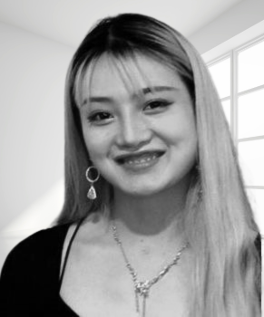
An Integrative Acupuncture-Based Model for Managing Depression, Anxiety, and ADHD
Mental health disorders such as depression, anxiety, and Attention Deficit Hyperactivity Disorder (ADHD) are increasingly prevalent in modern healthcare settings. These conditions often present concurrently and are commonly managed with pharmacological and psychological therapies. However, many patients seek integrative or alternative solutions due to side effects, limited access, or insufficient response to conventional treatments.
This presentation explores the clinical application of acupuncture as an adjunctive treatment for these disorders, offering a holistic and neurophysiologically informed approach.
Drawing from both Traditional Chinese Medicine (TCM) theory and emerging biomedical evidence, the presentation introduces a model of acupuncture treatment that focuses on regulating the autonomic nervous system, improving cerebral perfusion, and modulating neurotransmitter balance. Specific protocols, including scalp acupuncture for ADHD, Shen Men and HT chanel for anxiety, and Liver-Qi regulation for depression, will be detailed. Case examples and practical strategies for point selection, patient communication, and integrative care planning will also be discussed.
The presentation also highlights recent research findings supporting acupuncture’s role in modulating cortisol levels, activating parasympathetic tone, and improving attention and mood through vagal nerve pathways. By combining TCM diagnostic frameworks—such as Shen disturbance and Zang-Fu organ patterns—with contemporary neuroscience, practitioners can tailor treatments to suit individual presentations and improve clinical outcomes.
Ting Vivian
Wang

Slide 27
About the Presenter
Vivian Wang is a registered Traditional Chinese Medicine (TCM) practitioner with over nine years of clinical experience in New Zealand. She is skilled in both Chinese herbal medicine and acupuncture, holding a Bachelor of Clinical Medicine (specialising in Chinese Medicine) from Hubei University of Chinese Medicine and a Postgraduate Diploma in Health Science (Pain and Pain Management) from the University of Otago.
Vivian is an Executive Member of the World Federation of Acupuncture and Moxibustion Societies (WFAS), an Executive Member of the International Federation for Health and Wellness (IFHIA), and a Board Member of Acupuncture New Zealand. She also lectures and supervises at the New Zealand School of Acupuncture and Traditional Chinese Medicine, guiding students in both theoretical learning and hands-on clinical skills.
In addition to her academic and clinical work, Vivian serves as an External Advisor for Asian Family Services in the area of mental health. In 2O24, she collaborated with the organisation to complete a suicide prevention project aimed at supporting Asian communities in New Zealand.
Over the years, Vivian has developed a strong interest in the connections between pain and mental health conditions, recognizing that they share many common features. Through clinical practice, she has created an acupuncture-based treatment approach for depression, anxiety, and ADHD, integrating TCM principles with emerging biomedical research. This model focuses on regulating the autonomic nervous system, improving cerebral blood flow, and supporting neurotransmitter balance.

Slide 28
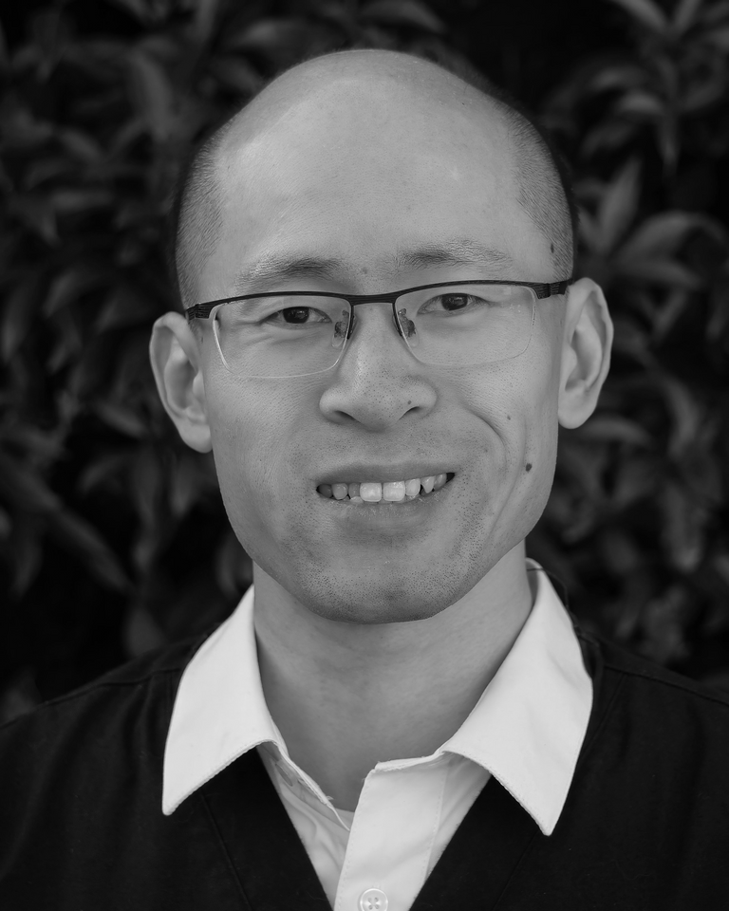
Workshop: Introduction into Pediatric Tuina
Pediatric Tuina (小儿推拿) is a valuable TCM external therapy, born from the wisdom of ancient folk practices and deeply embedded in community and family care. Its therapeutic touch resonates with healing modalities found worldwide, akin to Mirimiri within Rongoā Māori here in Aotearoa New Zealand.
As a gentle, natural, and non-invasive TCM approach for children's general health and proper development, Pediatric Tuina offers parents a crucial middle ground: a comforting and effective choice between watchful home observation and stressful queuing experiences at institutions like Starship Hospital.
This presentation will unpack Pediatric Tuina's unique theoretical foundations, introduce essential acupoints and iconic techniques, and walk through the diagnostic process behind treating common cases. My hope is to inspire fellow TCM practitioners, expanding your clinical toolkit and, through our hands, bring profound benefits to many more families.
Renjie Xi

Slide 29
About the Presenter
Renjie Xi is an Auckland-based member and Vice President of Acupuncture NZ. Completing an 8-year medical training programme at Nanjing University of Chinese Medicine in China he earned a Bachelor's and Master's Degrees in Medicine and practised as a resident doctor in a public hospital. He moved to New Zealand 7 years ago and became a registered Chinese Medicine Practitioner.
Renjie's special interest lies in Traditional Child Massage (Pediatric Tuina). This connection runs deep:
"my mum once told me how my great-grandmother would offer free massages to sick children in her village. This family legacy, combined with my professional training, inspires my approach. I use gentle, tailored techniques to support children with common health issues like digestive imbalances, sleep disorders, and immune support, encouraging their natural development. Parents often find this a comforting and effective approach for their little ones".

Slide 30
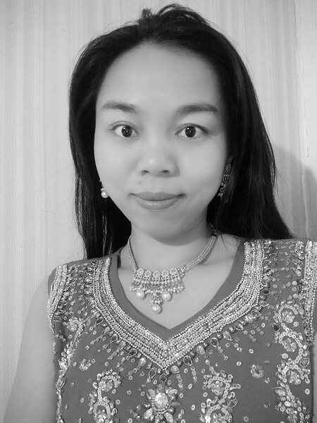
Workshop: Health Qigong and Therapeutic Tai Chi for Common Conditions: Preliminary Exploration, Application, and Training of TCM Exercise Prescriptions
In Traditional Chinese Medicine (TCM), movement is not only a means of exercise, but a therapeutic method rooted in the regulation of Qi, Blood, and Zang-Fu function. This practical workshop explores the initial integration of Health Qigong and Therapeutic Tai Chi into TCM exercise prescriptions for managing common modern disorders. Focusing on clinical application, the workshop will provide a lecture first then guide participants through tailored movement interventions addressing five frequently encountered conditions:
1. Chronic Lower Back Pain : Qigong & Tai Chi prescribed Movement
2. Digestive System Dysfunction: Qigong & Tai Chi prescribed Movement
3. Sleep Disorders : Qigong & Tai Chi prescribed Movement
4. Emotional Dysregulation : Qigong & Tai Chi prescribed Movement
5. Immune System Imbalance : Qigong & Tai Chi prescribed Movement
Throughout the session, each disease pattern will be briefly contextualized in TCM theory, followed by demonstration and guidedpractice of corresponding Qigong and Tai Chi forms. Emphasis will beplaced on breath regulation, intention (Yi), and movement precision, aligning with the principle of “preventive care” and “nurturing inmovement, healing in stillness”.
Learning Outcomes:
1. Understand foundational concepts of TCM-based movement prescriptions
2. Experience five functional movement sets for common conditions
3. Learn how to integrate movement-based interventions into acupuncture or integrative therapy settings
Peifeng
Alice Xian

Slide 31
About the Presenter
Peifeng Alice Xian - Taught TCM, Taichi, Tuina at the New Zealand School of Acupuncture and Traditional Chinese Medicine. Coached Taichi Qigong in schools, communities. Promotes Taichi activities. WFCMS committee member. Registered Taichi 6th Duan Coach. VP of NZ TaiChi Association, former TaiChi team captain.
Experienced Acupuncturist, TCM practitioner with focus on Acupuncture analgesia. Published 4 researches, 12 articles. Collaborated with physiotherapists, podiatrists, etc., for pain management.
2O16-Current
Vice president, Chief Yang style Taichi Coach of NZ Taichi Association
Coaching Yang & Chen style Taichi, Qigong in NZ Taichi Association

Slide 32
Looking forward to seeing you in November!
www.acupuncture.org.nz

